Slide 1

Advanced Control of a Non-Linear System
Control of Dynamic Systems :
Applications in Mobile Robotics and Aerospace
Master in smart aerospace and autonomous systems
Politechnika Poznańska - Poland
Auteurs / Authors
Jiokeng i toko jean junior maldini
frikrasselassie eshetu SEID

Slide 2
Table of Contents
I. Introduction
II. System Study
III. Simulink Model
IV. Conclusion

Slide 3

INTRODUCTION

Slide 4

Introduction
In fields like robotics, aeronautics, and aerospace, many systems are difficult to control because they react unpredictably. For example, a drone may react suddenly in the presence of wind, and an autonomous robot may be destabilized by irregular terrain. This project explores a method called linearization, which simplifies these systems to make them more predictable and easier to control.

Slide 5
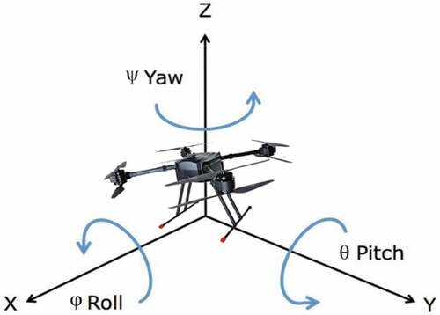
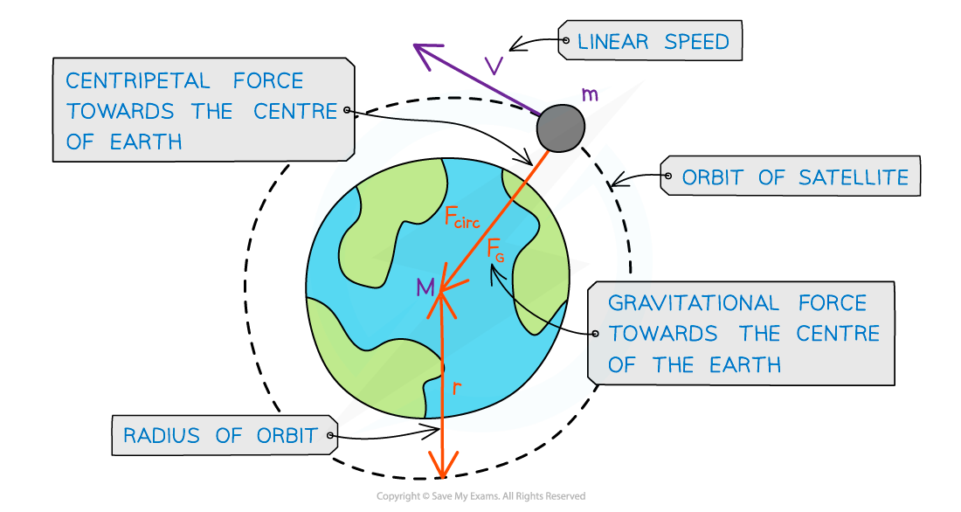
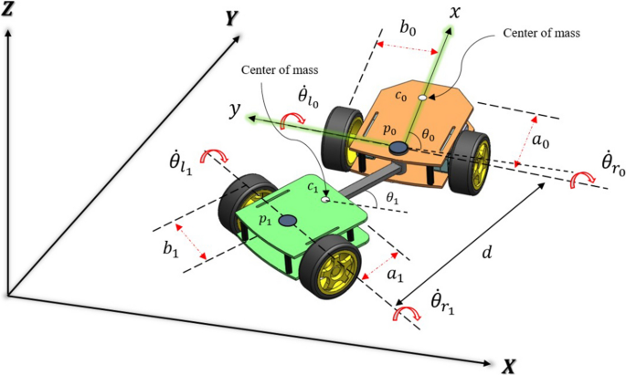
Understanding the Non-Linear System
We studied a complex dynamic system model, represented by a mathematical equation involving several variables (the system's internal values). This model includes non-linear effects, such as a sine function, making its behaviour difficult to predict. These non-linear effects often appear in:
Mobile Robots
Drones
Satellites
Where interactions with the ground may cause unstable movements
they respond unpredictably to turbulence or wind
gravitational variations may cause orbital discrepancies.

Slide 6
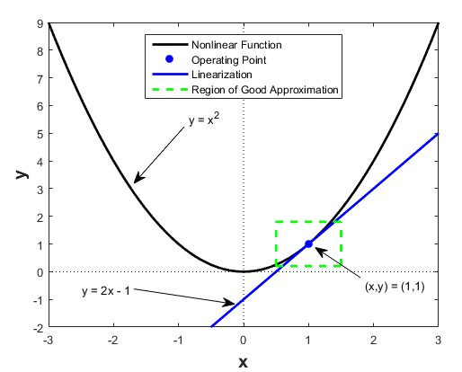
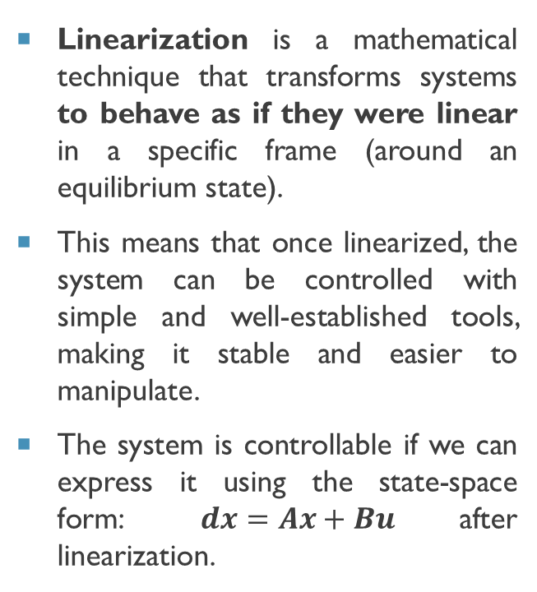
Why Linearize?
Linearization is a mathematical technique that transforms systems to behave as if they were linear in a specific frame (around an equilibrium state).
This means that once linearized, the system can be controlled with simple and well-established tools, making it stable and easier to manipulate.
The system is controllable if we can express it using the state-space form: $dx=Ax+Bu$ after linearization.

Slide 7

System Study

Slide 8
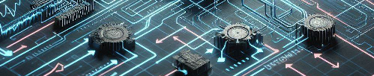
WORKING STEPS
In this project, we explored the linearization of a complex dynamic system using two specific techniques:
State Transformation
Feedback Control
By simplifying and stabilizing this non-linear system, we obtained a model that is easier to analyse and control. This approach is particularly useful in areas like aerospace and autonomous systems, where stability and precision are essential.

Slide 9
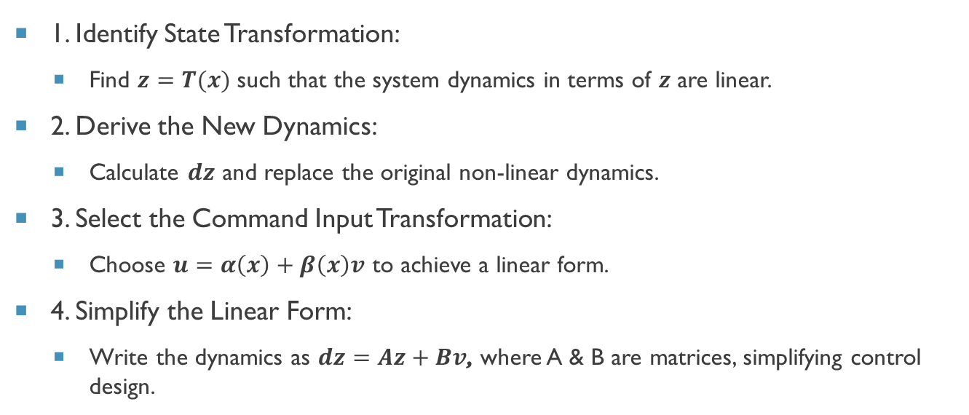
Methodology and Calculations
1. Identify State Transformation:
Find $z=T(x)$ such that the system dynamics in terms of $z$ are linear.
2. Derive the New Dynamics:
Calculate $dz$ and replace the original non-linear dynamics.
3. Select the Command Input Transformation:
Choose $u=α\left(x\right)+β\left(x\right)v$ to achieve a linear form.
4. Simplify the Linear Form:
Write the dynamics as $dz=Az+Bv$, where A & B are matrices, simplifying control design.

Slide 10
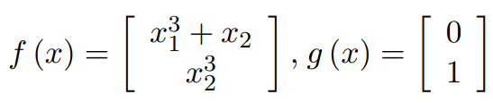
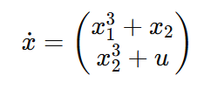
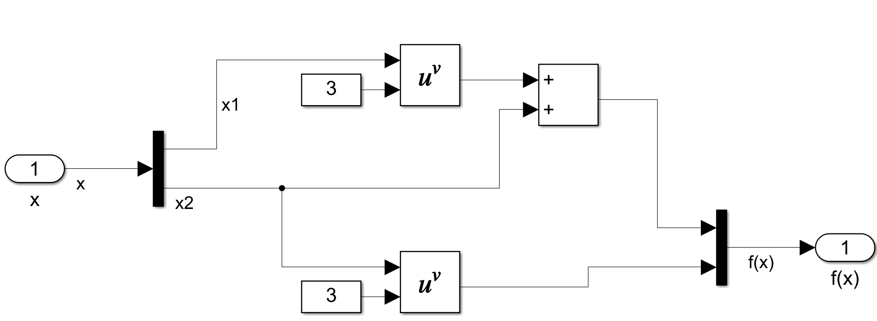
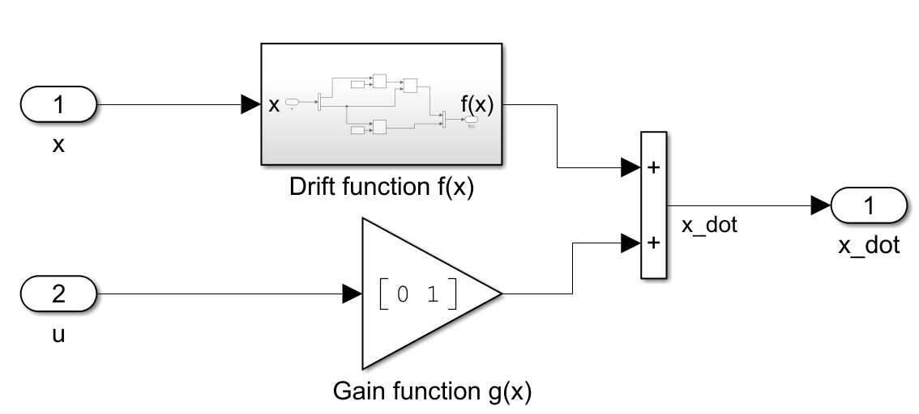
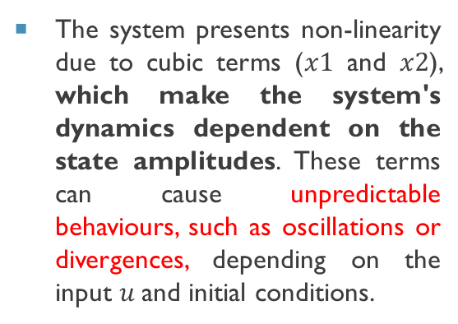
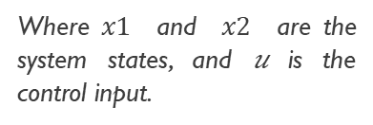
Presenting Our Non-Linear System
We worked with a non-linear model represented by the equation :
Where $x1$​ and $x2$​ are the system states, and 𝑢 is the control input.
;
The system presents non-linearity due to cubic terms ($x1$ and $x2$​), which make the system's dynamics dependent on the state amplitudes. These terms can cause unpredictable behaviours, such as oscillations or divergences, depending on the input $u$and initial conditions.
Representation of the system in MATLAB Simulink

Slide 11
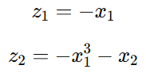
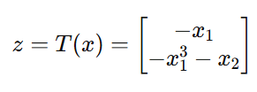
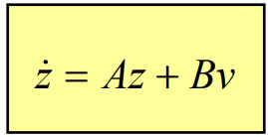
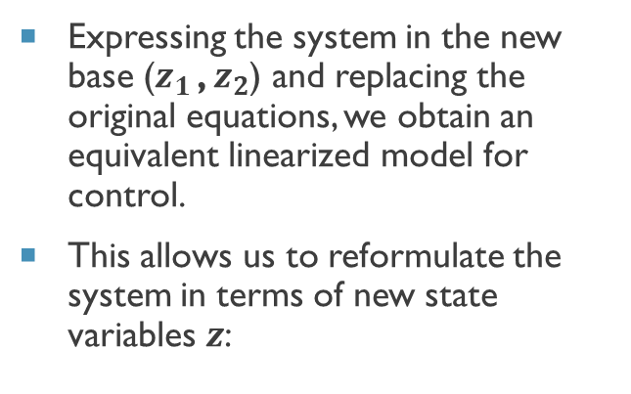
LINEARISATION
Linearization by State Transformation
New Dynamics:
By applying a state transformation, we rewrite the equations to obtain a simplified version.
After calculation, we find that the state transformation to apply is as follows:
Expressing the system in the new base ($z_{1 }$​, $z_{2}$) and replacing the original equations, we obtain an equivalent linearized model for control.
This allows us to reformulate the system in terms of new state variables $z$:
=>

Slide 12
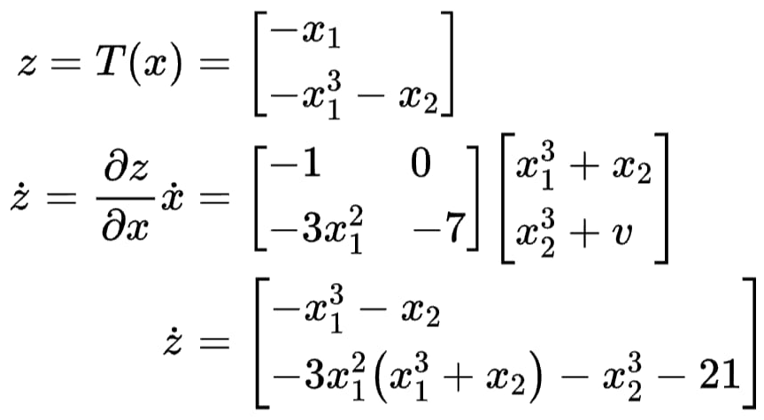
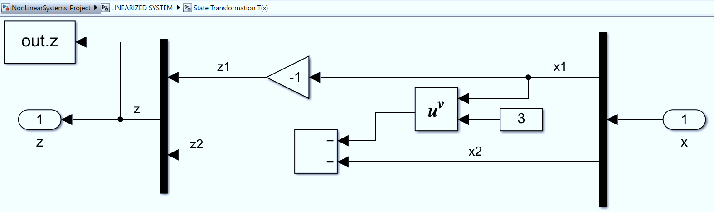
Presentation of Our Non-Linear System
We worked with a non-linear model represented by the equation:
Representation of the system in MATLAB Simulink

Slide 13
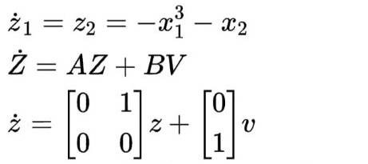
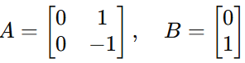
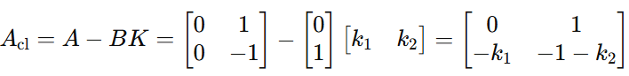
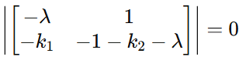
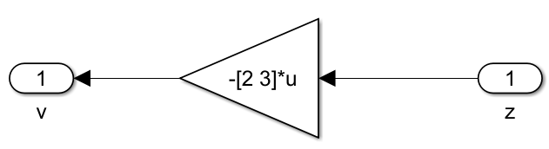
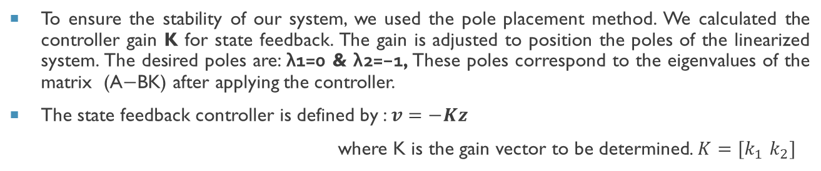
Design of Feedback Controller
Calculation of Control with the Pole Placement Method
To ensure the stability of our system, we used the pole placement method. We calculated the controller gain K for state feedback. The gain is adjusted to position the poles of the linearized system. The desired poles are: λ1​=0 & λ2​=−1, These poles correspond to the eigenvalues of the matrix (A−BK) after applying the controller.
The state feedback controller is defined by : $v=−Kz$
where K is the gain vector to be determined. $K={[k}_{1}$ $k_{2}]$
det (Acl​−λI)=0 =>
Representation of the system in MATLAB Simulink
K = [2 3]

Slide 14
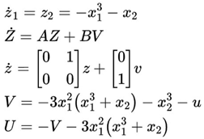
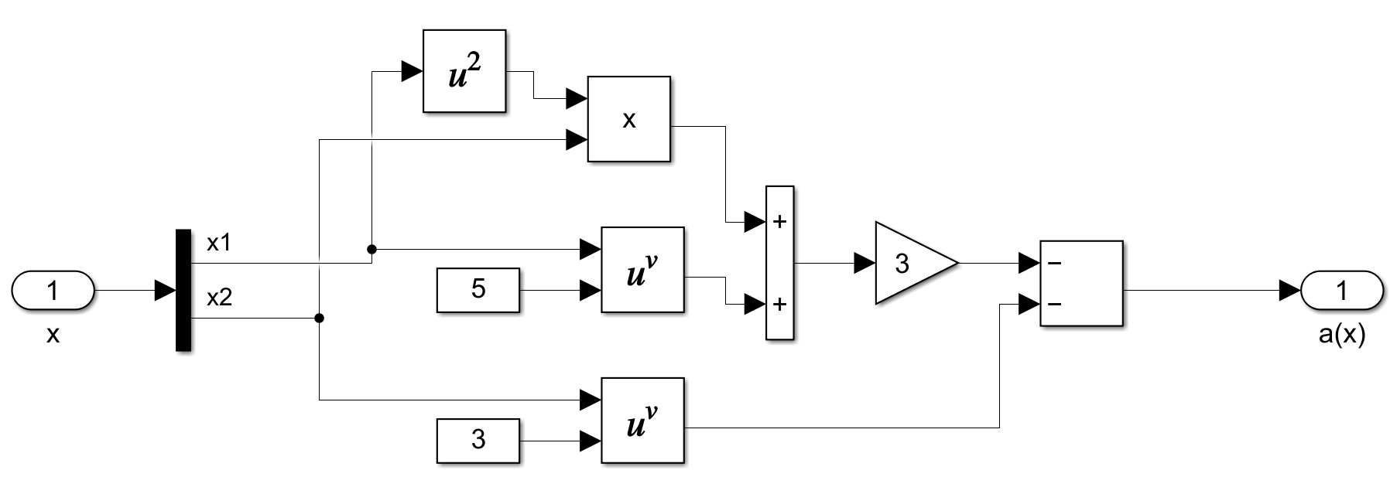
Controller with Linearized Input
Simulations were conducted in Simulink (MATLAB environment) to validate our approach and calculations :
Representation of the system in MATLAB Simulink

Slide 15
Matlab simulink
Implementation of our model

Slide 16
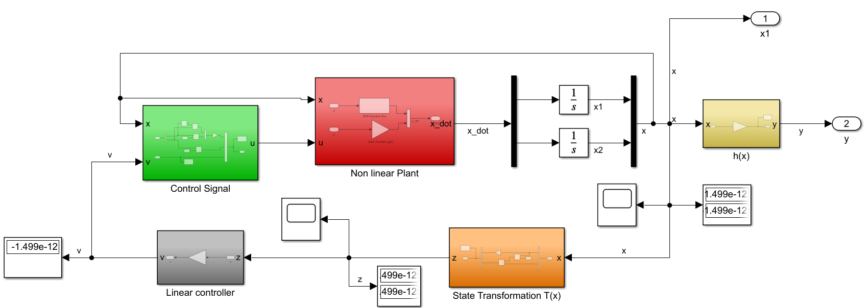
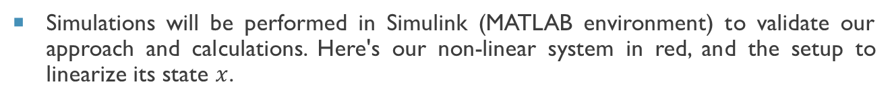
SIMULINK - LINEARIZED SYSTEM
Simulations will be performed in Simulink (MATLAB environment) to validate our approach and calculations. Here's our non-linear system in red, and the setup to linearize its state $x$.

Slide 17
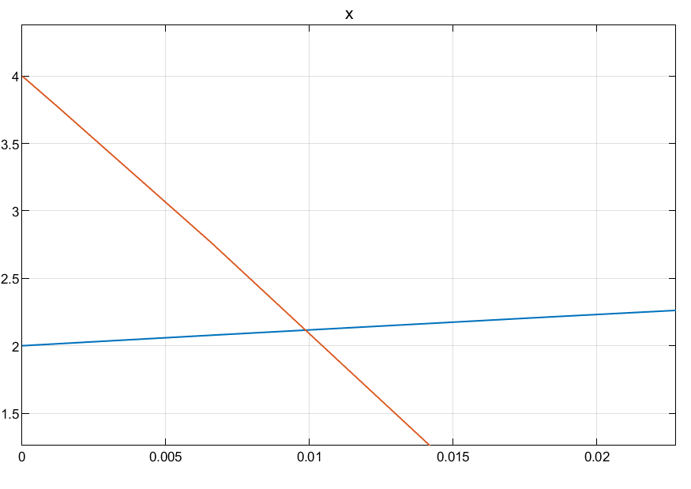
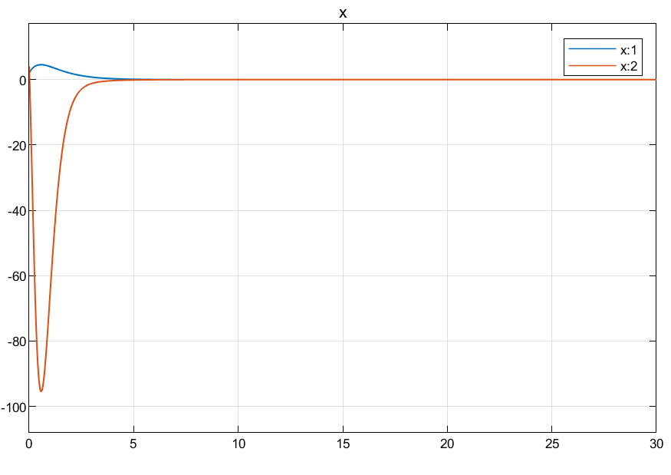
SIMULINK - LINEARIZED SYSTEM LINEARIZED SYSTEM STABILITY TEST
1st Test : x1 = 2 & x2 = 4
We initialize our system at a position different from its equilibrium point x=[0; 0], to verify it will return to the equilibrium position.
CONCLUSION
Initially, the system does deviate from defined positions, but after 5 sec, the system stabilizes.

Slide 18
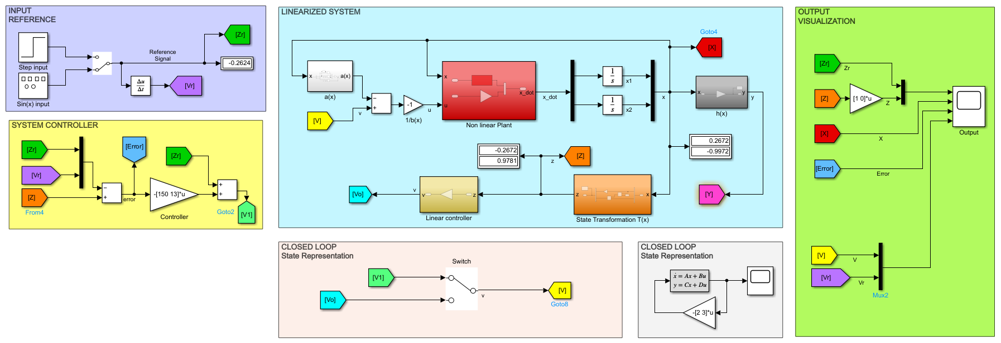
LINEARIZED SYSTEM WITH REFERENCE INPUT CONTROL OF THE LINEARIZED SYSTEM
Principle : We now have the complete representation of our system equipped with an input. The principle is simple: define a signal that serves as a reference for our model. With our controller gain K, we can command our robot to track this reference.

Slide 19
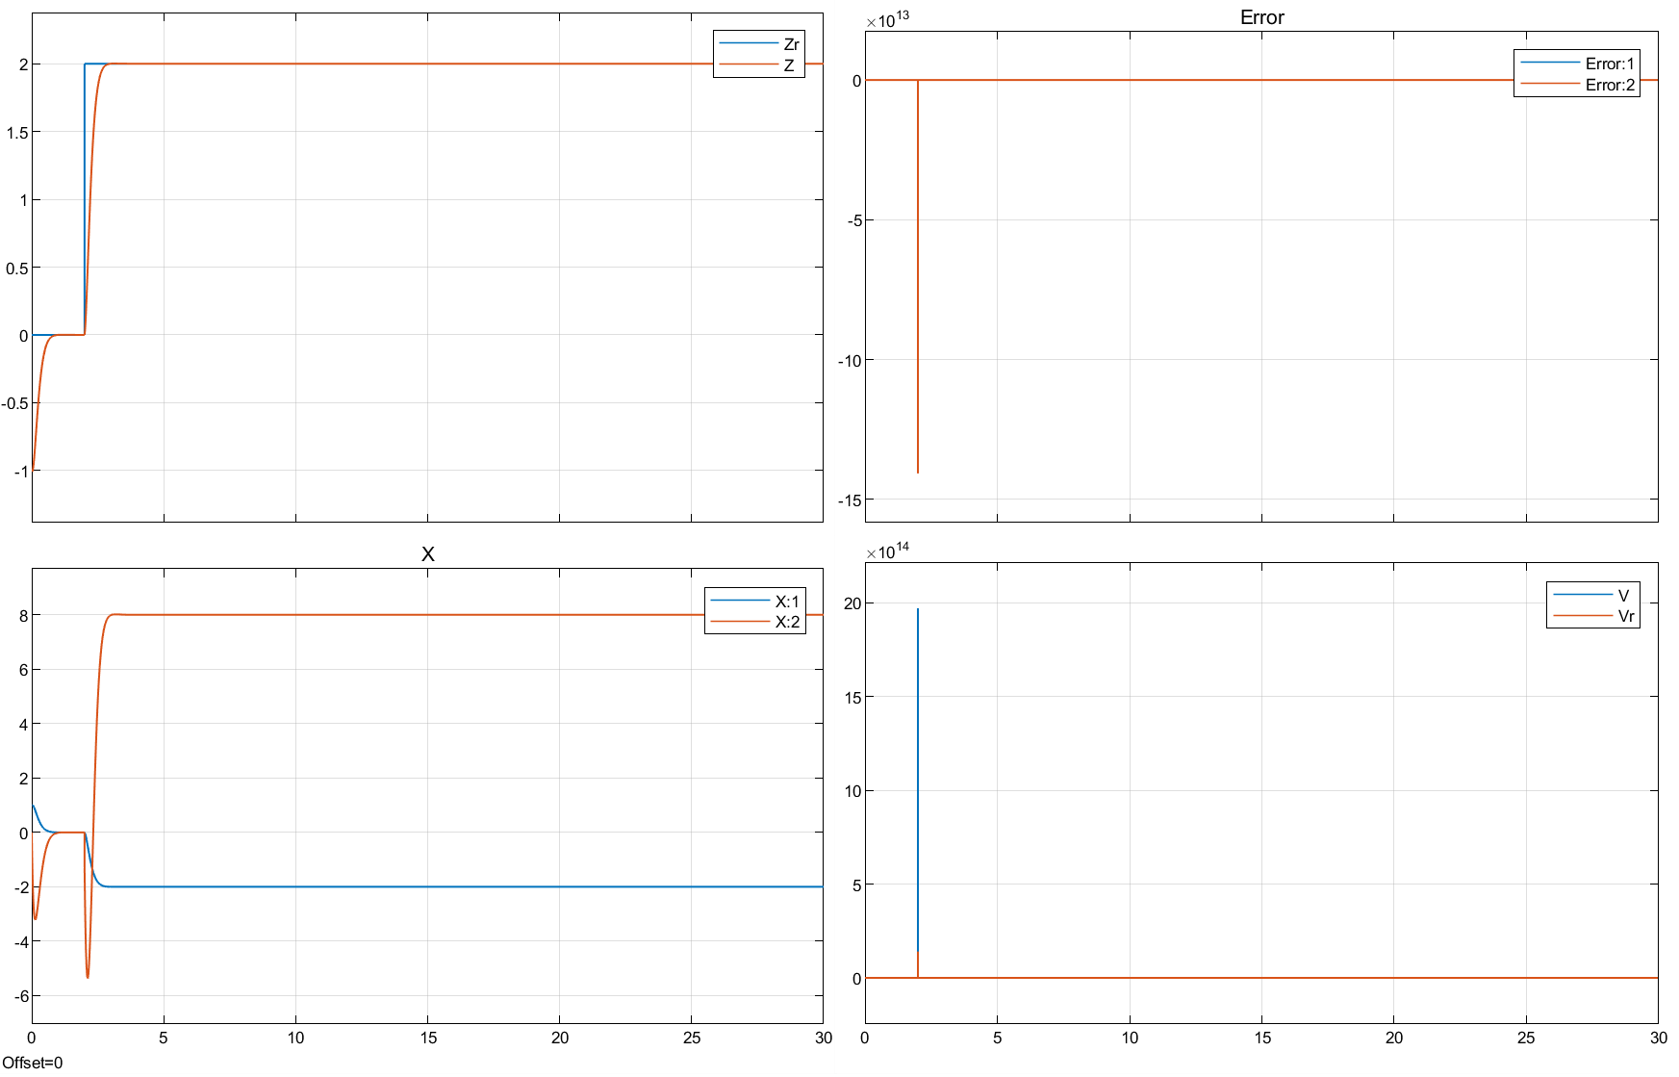
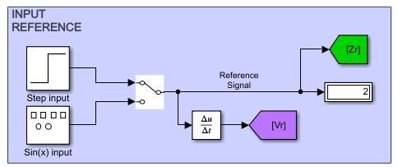
SIMULINK - LINEARIZED SYSTEM LINEARIZED SYSTEM STABILITY TEST
2nd Test :
We send a pulse of value 2, which will trigger at 2 sec. This represents our reference trajectory Zr; Since we left the system in an unstable position (x ≠ 0), we will now observe the behaviour of the output Z with respect to Zr​.

Slide 20
SIMULINK - LINEARIZED SYSTEM LINEARIZED SYSTEM STABILITY TEST
CONCLUSION
At first, the system starts from unstable positions. 1 sec is enough for it to stabilize and begin tracking the reference. It experiences a slight delay due to the sudden impulse at 2 sec, but it reaches the reference at around 1.8 sec, and the tracking becomes perfect afterward (Error → 0). In this case, tracking is more obvious because our reference trajectory is a linear function (y = Zr = 2).
What would we have in terms of response time, robustness, and stability with respect to a non-linear reference trajectory Zr​?

Slide 21
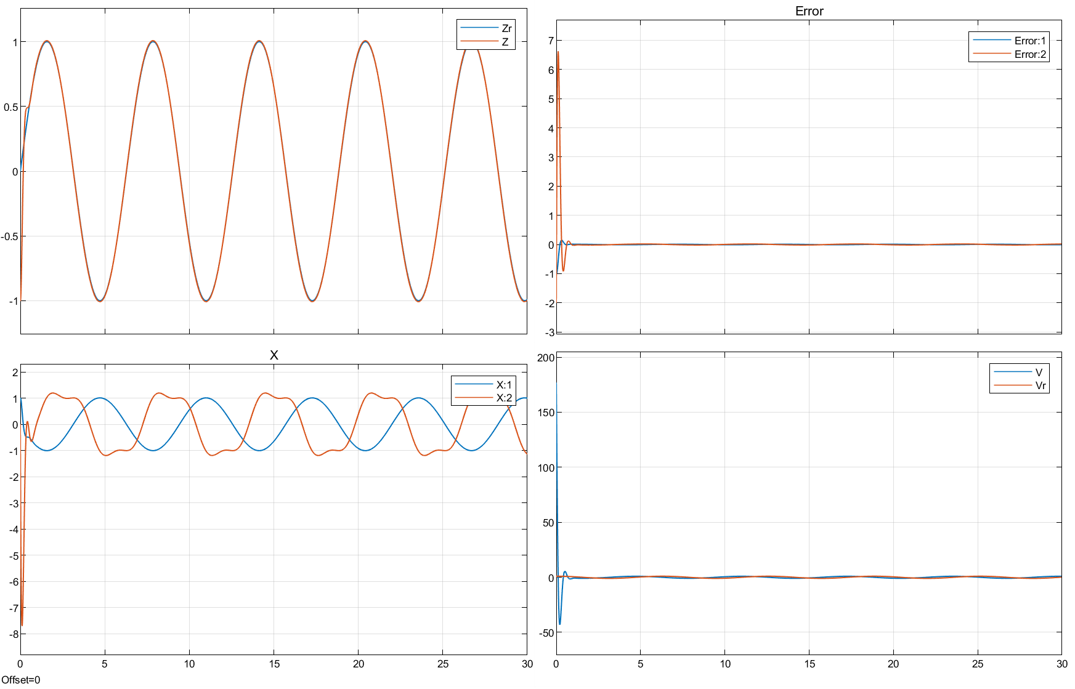
SIMULINK - LINEARIZED SYSTEM LINEARIZED SYSTEM STABILITY TEST
3rd Test :
Our reference trajectory Zr is a sinusoidal function ;
Since we left the system in an unstable position (x ≠ 0), we will now study the behaviour of the output Z with respect to Zr = sin⁡(x).

Slide 22

SIMULINK - LINEARIZED SYSTEM LINEARIZED SYSTEM STABILITY TEST
CONCLUSION
At first, the system starts from unstable positions, but it successfully tracks the target within approximately 0.6 sec, and then the tracking becomes perfect (Error → 0). The tracking is even faster as we increased the controller gain, knowing that the trajectory was non-linear, which initially caused some state drift, but the system quickly resolved this deviation. So, we have the proof! We linearized our system and applied a control command while maintaining its stability.
Therefore, our system can even track a mythical dragon, if we consider Zr​ as the movement curve of a dragon, for example!

Slide 23
CONCLUSION
The results obtained confirm that linearization is a powerful method to transform complex dynamic systems into controllable and predictable models. With this approach, we were able to improve the system's stability, robustness against disturbances, and the speed of the system's responses. These qualities are essential in many modern applications where precision and reliability are critical.
The results show that linearization is not just a mathematical theory; it is a concrete and effective solution to tackle the challenges of non-linear systems in the real world. This advancement opens the way for innovations that are safer and more efficient in fields like robotics, aeronautics, and aerospace.
By mastering these techniques, we are preparing the ground for tomorrow's technologies, capable of meeting the most demanding challenges.
Concrete Application Examples
Delivery Drones: With increased stability, they can fly safely, even in strong winds, to deliver packages in hard-to-reach areas.
Search and Rescue Robots: On rugged terrain, robustness allows these robots to remain operational despite unforeseen conditions.
Communication Satellites: A quick and predictable response ensures perfect alignment for continuous network coverage.
Autonomous Vehicles: By maintaining stability in complex situations, linearization contributes to safer and more reliable driving.

Slide 24



Thank you for your attention!
Contact Us
Linkedin :
https://linkedin.com/in/toko1ejm
Toko 1er Jean Maldini
Student Smart aerospace and autonomous systems
Linkedin :
https://linkedin.com/in/fikreselassie-seid
Fikreselassie Eshetu Seid
Student Smart aerospace and autonomous systems
Thanks to Mohammed A M Safarini
Assistant professeur, étudiant en PhD
Free document | Available in 3 languages | Fr – En – De

